Slide 1

SNAKE GAME.. B.TECH 2022-26 3RD SEM LEARNING PROJECT Submitted by GANESH kumar , ABHIJEET KUMAR , SANTU DAS Roll No- 22CSE004 , 22CSE008 , 22CSE100 Under the Guidance of Asst. Prof: mr. D.ANIL KUMAR BACHELOR of TECHNOLOGY DEPARTMENT OF COMPUTER SCIENCE & ENGINEERING GANDHI INSTITUTE OF ENGINEERING & TECHNOLOGY UNIVERSITY, GUNUPUR- 765022, ODISHA

Slide 2

INTRODUCTION
The Snake game is a classic and straightforward arcade game in which players control a snake on a grid or playing field. The objective is to guide the snake to eat food items (usually represented as dots) that appear on the screen. As the snake consumes these food items, it grows longer, making the game progressively more challenging. The main challenge is to avoid running into the walls of the playing area or colliding with the snake's own tail. The game typically becomes faster as the snake gets longer, testing the player's reflexes and strategic planning. It's a simple yet addictive game that has been enjoyed by players for decades.

Slide 3
OBJECTIVE
The objective of the Snake game is to control a snake and achieve a high score by fulfilling the following goals:
Eating Food: The primary objective is to guide the snake to consume food items (often represented as dots or other symbols) that appear on the game board. Each time the snake eats food, it grows longer.
Growing the Snake: As the snake eats, it increases in length. The more food the snake consumes, the longer it becomes. This adds a level of complexity to the game because the longer snake is more challenging to maneuver.
Avoiding Collisions: The key challenge in the game is to prevent the snake from colliding with the boundaries of the play area or running into its own tail. Collisions with walls or self-implosion result in the game ending.
Achieving a High Score: Players aim to achieve the highest score possible by collecting as much food as they can without colliding with obstacles or themselves. The score typically increases with each food item consumed.
The game's objective is simple, but as the snake grows longer and the pace of the game increases, it becomes progressively more challenging. The ultimate goal is to beat one's own high score or compete with others to see who can achieve the highest score while navigating the snake effectively and avoiding collisions.

Slide 4
HARDWARE REQUIREMENT
Snake Game classic Minimum requirements
Memory: 4 GB.
Graphics Card: ATI FireGL T2-128.
CPU: Intel Pentium 4 2.00GHz.
OS: Windows 7/8/10/11.

Slide 5


SOFTWARE REQUIREMENT
LANGUAGE USED
VS CODE
NOTEPAD
BROWSER
GDB
LIVE SERVER
1. HTML
2. CSS
3. JAVASCRIPT

Slide 6
HTML Structure:
The game utilizes HTML to construct the canvas, grid, score display, and user interface components essential for gameplay.
CSS Styling:
CSS enhances the game's aesthetics, styling the snake, food items, grid, and interface elements. Animations and transitions lend fluidity to the snake's movement.
JavaScript Logic:
The core game behavior is managed by JavaScript, handling user input for snake movement, detecting collisions, and updating the game state.

Slide 7
METHODOLOGY
The game is played on a grid-based world , typically a rectangular grid, where the snake and food elements move and interact.
The snake's initial position, direction, and length are set , And the snake moves in discrete steps, usually one grid cell at a time.
The snake's movement direction is controlled by the player using arrow keys or similar controls.
If the snake collide Food items are randomly placed on the grid. When the snake's head collides with a food item, the snake's length increases, simulating growth.
A scoring mechanism keeps track of the player's score based on the number of food items consumed.
The game ends when the snake collides with a wall or itself.
The final score is displayed, and the player may choose to start a new game.
9

Slide 8
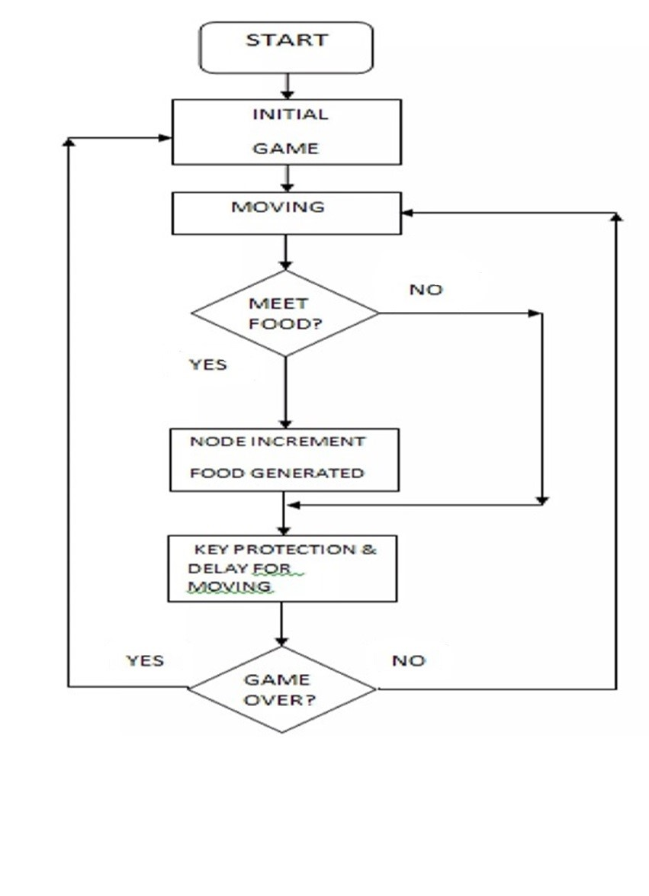
Flow Chart

Slide 9
CODE PEICE
JAVASCRIPT // Game Constants & Variables
let inputDir = {x: 0, y: 0};
const foodSound = new Audio('music/food.mp3');
const gameOverSound = new Audio('music/gameover.mp3');
const moveSound = new Audio('music/move.mp3');
const musicSound = new Audio('music/music.mp3');
let speed =6;
let score = 0;
let lastPaintTime = 0;
let snakeArr = [
{x: 13, y: 15}
];
food = {x: 6, y: 7};
// Game Functions
function main(ctime) {
window.requestAnimationFrame(main);
// console.log(ctime)
if((ctime - lastPaintTime)/1000 < 1/speed){
return;
}
lastPaintTime = ctime;
gameEngine();
} function isCollide(snake) {
// If you bump into yourself
for (let i = 1; i < snakeArr.length; i++) {
if(snake[i].x === snake[0].x && snake[i].y === snake[0].y){
return true;
}
}
// If you bump into the wall
if(snake[0].x >= 18 || snake[0].x <=0 || snake[0].y >= 18 || snake[0].y <=0){
return true;
}
return false;
}
HTML
<!DOCTYPE html>
<html lang="en">
<head>
<title>Snake game</title>
<link rel="stylesheet" href="style.css">
</head>
<body>
<div class="body">
<div id="scoreBox">Score: 0</div>
<div id="hiscoreBox">High Score: 0</div>
<div id="board"></div>
</div>
</body>
<script src="javascript.js"></script>
</html>

Slide 10
Java script
// Part 2: Display the snake and Food
// Display the snake
board.innerHTML = "";
snakeArr.forEach((e, index)=>{
snakeElement = document.createElement('div');
snakeElement.style.gridRowStart = e.y;
snakeElement.style.gridColumnStart = e.x;
if(index === 0){
snakeElement.classList.add('head');
}
else{
snakeElement.classList.add('snake');
}
board.appendChild(snakeElement);
});
// Display the food
foodElement = document.createElement('div');
foodElement.style.gridRowStart = food.y;
foodElement.style.gridColumnStart = food.x;
foodElement.classList.add('food')
board.appendChild(foodElement); }
function gameEngine(){
// Part 1: Updating the snake array & Food
if(isCollide(snakeArr)){
gameOverSound.play();
musicSound.pause();
inputDir = {x: 0, y: 0};
alert("Game Over. Press any key to play again!");
snakeArr = [{x: 13, y: 15}];
musicSound.play();
score = 0;
}
// If you have eaten the food, increment the score and regenerate the food
if(snakeArr[0].y === food.y && snakeArr[0].x ===food.x){
foodSound.play();
score += 1;
if(score>hiscoreval){
hiscoreval = score;
localStorage.setItem("hiscore", JSON.stringify(hiscoreval));
hiscoreBox.innerHTML = "HiScore: " + hiscoreval;
}
scoreBox.innerHTML = "Score: " + score;
snakeArr.unshift({x: snakeArr[0].x + inputDir.x, y: snakeArr[0].y + inputDir.y});
let a = 2;
let b = 16;
food = {x: Math.round(a + (b-a)* Math.random()), y: Math.round(a + (b-a)* Math.random())}
}
// Moving the snake
for (let i = snakeArr.length - 2; i>=0; i--) {
snakeArr[i+1] = {...snakeArr[i]};
}
snakeArr[0].x += inputDir.x;
snakeArr[0].y += inputDir.y;

Slide 11
// Main logic starts here
musicSound.play();
let hiscore = localStorage.getItem("hiscore");
if(hiscore === null){
hiscoreval = 0;
localStorage.setItem("hiscore", JSON.stringify(hiscoreval))
}
else{
hiscoreval = JSON.parse(hiscore);
hiscoreBox.innerHTML = "HiScore: " + hiscore;
} window.requestAnimationFrame(main);
window.addEventListener('keydown', e =>{
inputDir = {x: 0, y: 1} // Start the game
moveSound.play();
switch (e.key) {
case "ArrowUp":
console.log("ArrowUp");
inputDir.x = 0;
inputDir.y = -1;
break;
case "ArrowDown":
console.log("ArrowDown");
inputDir.x = 0;
inputDir.y = 1;
break;
case "ArrowLeft":
console.log("ArrowLeft");
inputDir.x = -1;
inputDir.y = 0;
break;
case "ArrowRight":
console.log("ArrowRight");
inputDir.x = 1;
inputDir.y = 0;
break;
default:
break;
}
});

Slide 12
CSS
*{
padding: 0;
margin: 0;
}
.body{
background: url("bg1.jpg");
min-height: 100vh;
background-size: 100vw 100vh;
background-repeat: no-repeat;
display: flex;
justify-content: center;
align-items: center;
}
#scoreBox{
position: absolute;
top: 9px;
right: 150px;
font-size: 39px;
font-weight: bold;
font-family:'Lucida Sans', 'Lucida Sans Regular', 'Lucida Grande', 'Lucida Sans Unicode', Geneva, Verdana, sans-serif
}
#hiscoreBox{
position: absolute;
top: 59px;
right: 100px;
font-size: 39px;
font-weight: bold;
# font-family:'Lucida Sans', 'Lucida Sans Regular', 'Lucida Grande', 'Lucida Sans Unicode', Geneva, Verdana, sans-serif
}
#board{
background: linear-gradient(rgb(236, 237, 180), rgb(246, 174, 42));
width: 66vmin ;
height: 68vmin;
border: 2px solid black;
display: grid;
grid-template-rows: repeat(18, 1fr);
grid-template-columns: repeat(18, 1fr);
}
.head{
background: linear-gradient(rgb(14, 239, 37), rgb(17, 68, 2));
border: 2px solid rgb(34, 4, 34);
transform: scale(1.02);
border-radius: 9px;
}
.food{
background: linear-gradient(red, purple);
border: .25vmin solid black;
border-radius: 8px;
}

Slide 13
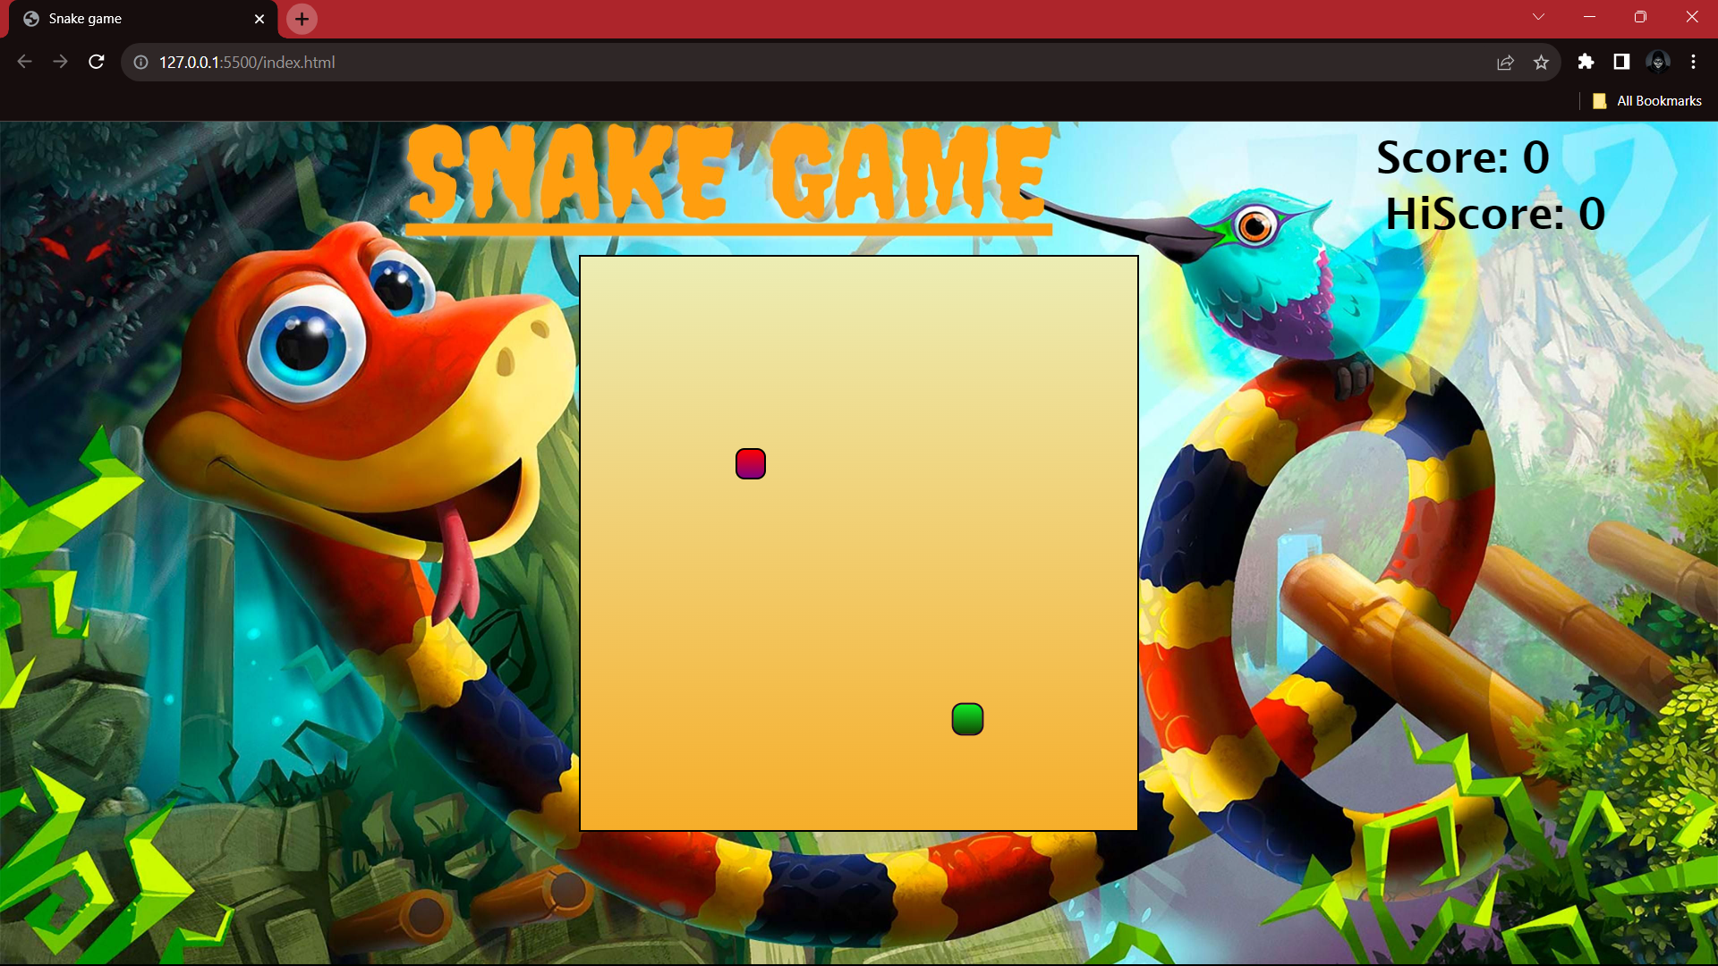
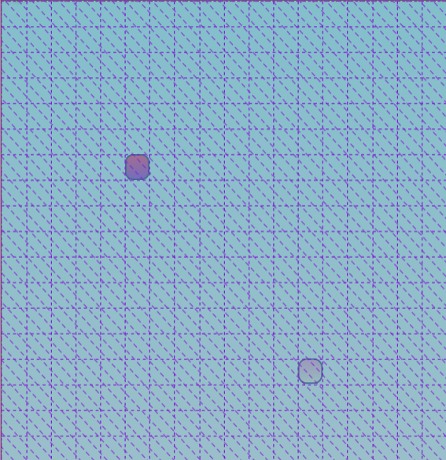
Score board
Grid(18 x 18)
Snake Head
Snake Food

Slide 14
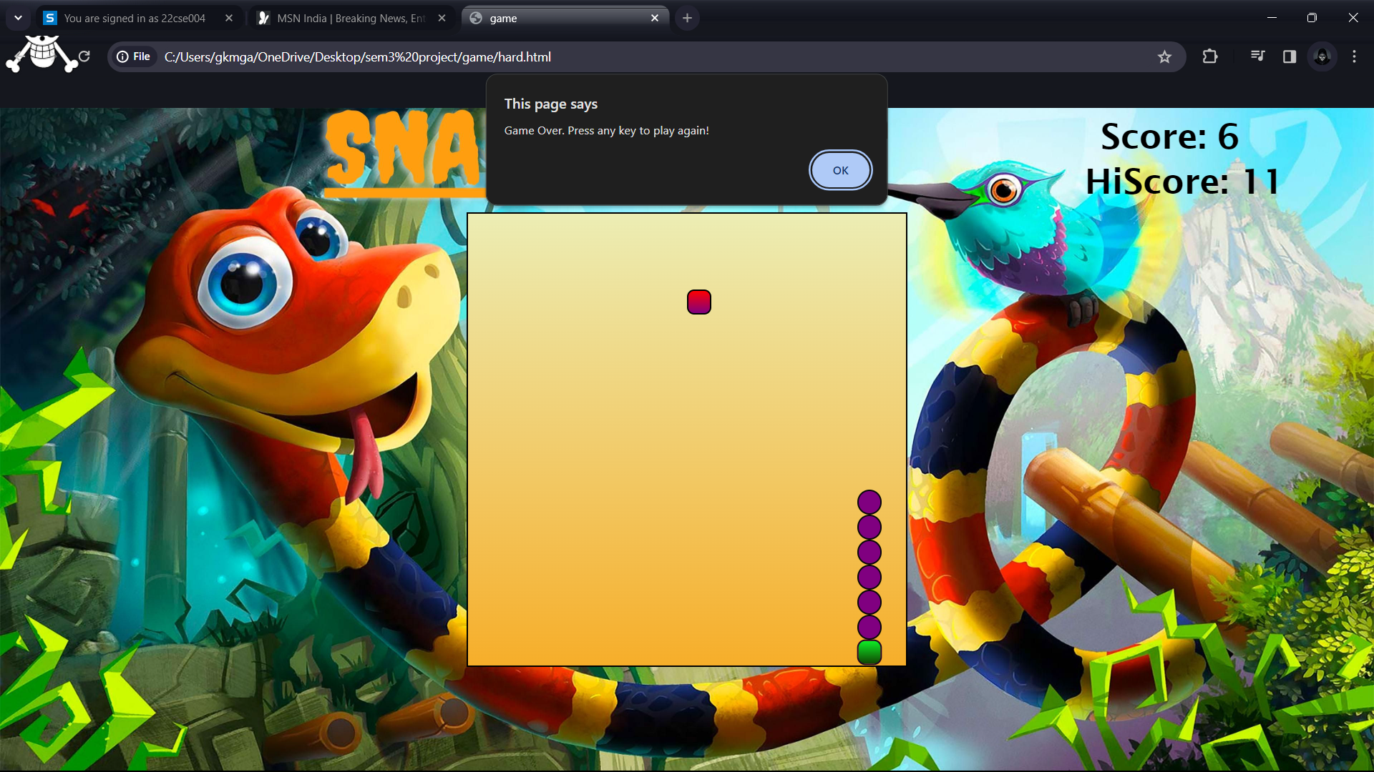

Slide 15
CONCLUSION
The Snake game is a timeless classic in the world of video games. Its simple yet addictive gameplay, along with its easy-to-understand mechanics, has made it a beloved choice for gamers of all ages. The game's objective of controlling a snake to eat food while avoiding collisions with obstacles or itself has provided hours of entertainment and challenged players to improve their skills.

Slide 16
Thank you
GANESH KUMAR-22CSE004
ABHIJEET KUMAR- 22CSE008
SANTU DAS– 22CSE100

